Slide 1

LEAD2024
Working With Boards
Tuesday, March 12, 2024

Slide 2


Slide 3
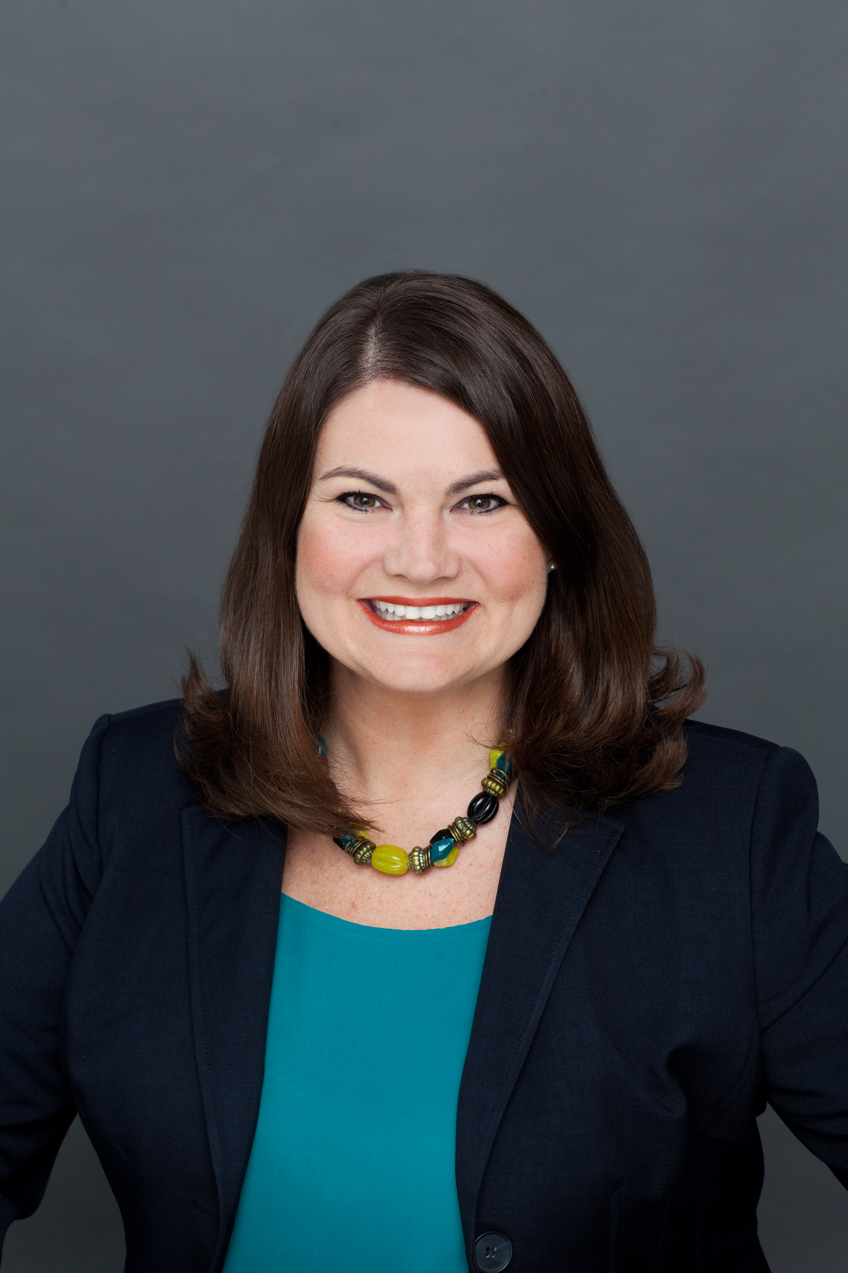
Certified Fundraising Executive
Certified in Corporate Citizenship
Over 20 years in community leadership roles
  Corporate giving
  Fundraising
  Board service
  Capital campaigns
  Special event committees
  Consulting
Adrienne Selsor, CFRE

Slide 4
TODAY’S OBJECTIVES
Share governance best practices
Provide templates to use immediately
Share resources to help with your biggest needs
Help with strategies to be more effective
Thank you and support your hard work
Answer your survey questions
Increase confidence & partnerships
BoardSource documents used with permission from www.boardsource.org. BoardSource is the premier resource for practical information, tools, and training for board members and chief executives of nonprofit organizations worldwide. For more information about BoardSource, visit www.boardsource.org or call 800-883-6262. BoardSource © [2024]. Content may not be reproduced or used for any purpose other than that which is specifically requested without written permission from BoardSource.

Slide 5
INTRODUCTIONS
Who you are
How long you’ve been in the nonprofit sector
How long you’ve been in this role

Slide 6
Education: Ten Basic Responsibilities of Nonprofit Boards
- Per BoardSource © [2024]
North Star
Determine mission and purpose.
Hire Top Leader
Select the chief executive.
Support Leader
Support and evaluate the chief executive.
Planning
Ensure effective planning.
Monitoring
Monitor and strengthen programs and services.
Financial Resources
Ensure adequate financial resources.
Financial Oversight
Protect assets and provide proper financial oversight.
Board Governance
Build a competent board.
Integrity & Ethics
Ensure legal and ethical integrity.
PR
Enhance the organization’s public standing.

Slide 7
We Hear You
Board Committee Usage & Goals - Utilization of board committees to streamline processes and efficiency. Establishing board committee goals.
Board Development - Board development opportunities.
Board Evaluations - Conducing annual board evaluations.
Education & Engagement - Engaging and educating the board on organizational programs and services.
Effective Board Meetings - Board meeting structure, agenda, and materials are not always useful and effective.
Financial Education - Board understanding of financial health and oversight of fiscal needs/strategy. Not all board members understand fiscal reports.

Slide 8
We Hear You
Fundraising - Strengthening board’s role in fundraising.
Board vs. Staff Responsibilities - Maintaining roles and responsibilities separate. Sometimes board members drift into areas that are assigned to staff. Engaging board in decision-making when appropriate.
Legal Responsibilities - Board awareness of legal responsibilities.
Polices & Procedures - Regular policy review and updates.
Recruitment, Selection & Onboarding - Board selection, recruitment, and orientation need improvement. Identifying gaps in board skills and expertise.
Strategic Planning - Board commitment to strategic planning and preparation for future needs.

Slide 9
Work Prior to Joining The Board Is Essential
Board Recruitment
Governance
Onboarding

Slide 10
Board Recruitment
How do you currently recruit board members?
What expectations are shared with board members?

Slide 11


Work Prior to Joining The Board Is Essential
Board Recruitment
  Utilize a nominations committee
  Don’t just take anyone
Board Governance
  Have board terms and enforce them
  Do not keep people not upholding their duties

Slide 12
Clear Expectations During Recruitment
Use a matrix – demographics, skills
Know their “why”/recruit for passion
Provide a one-page overview about expectations
Reinforce fundraising as a key element of Board service
Share a menu of investment opportunities
**If you don’t have these, this would be a great job for a standing or ad hoc board committee**

Slide 13
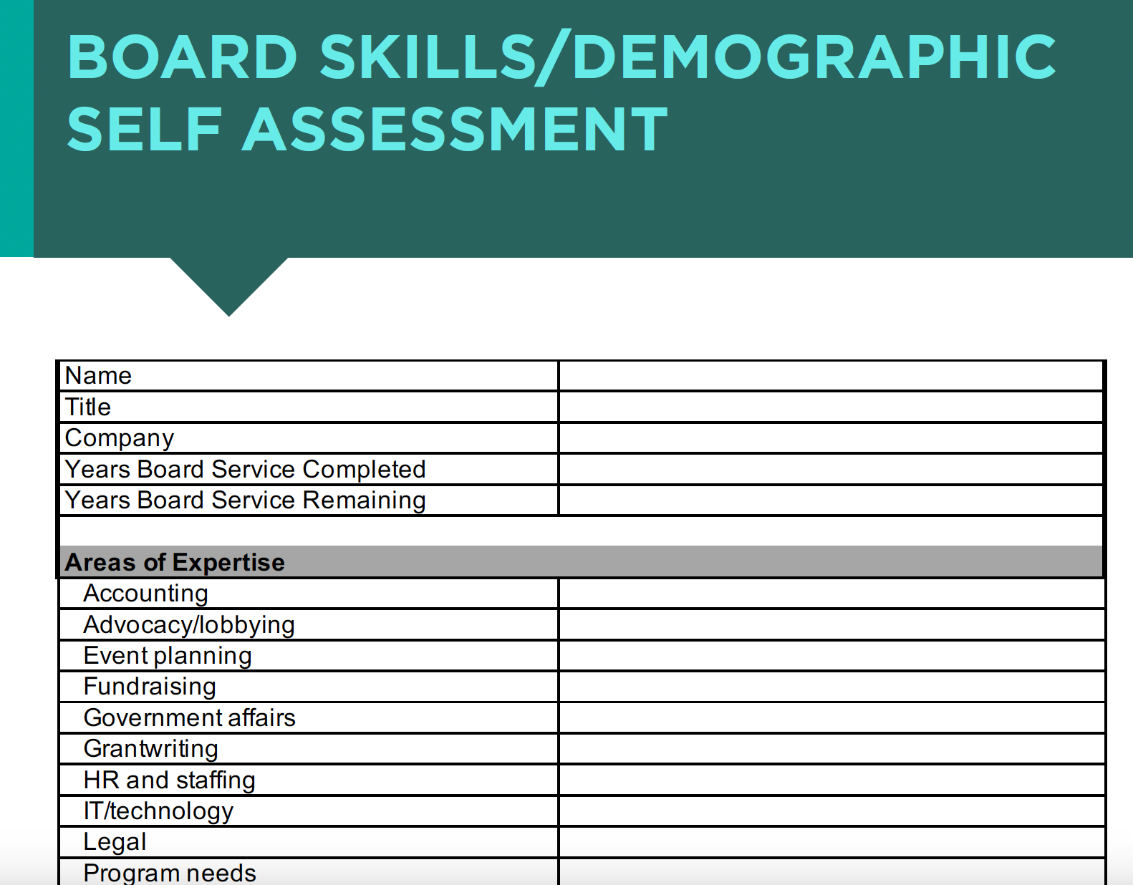
Work Prior to Joining The Board: Board Skillsets

Slide 14
Work Prior to Joining The Board: Board Skillsets
Areas of Expertise
Charitable Giving
Community Connections
Age
Gender
Race
Sexual Orientation

Slide 15
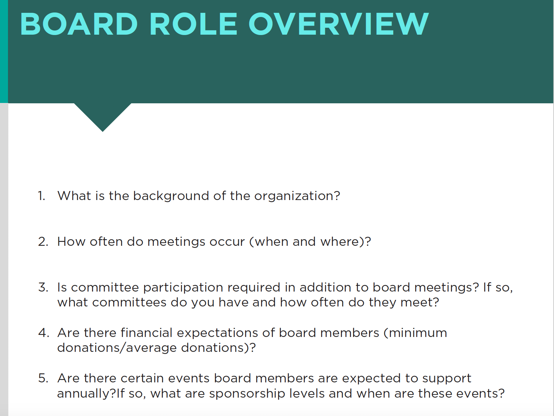
Work Prior to Joining The Board: Board Role Overviews

Slide 16
About organization
When meetings occur and where
Committee requirements
Financial expectations
Events expected to support
Board terms
Current board members
Current major objectives of board
Experience you are seeking
Work Prior to Joining The Board: Board Role Overviews

Slide 17
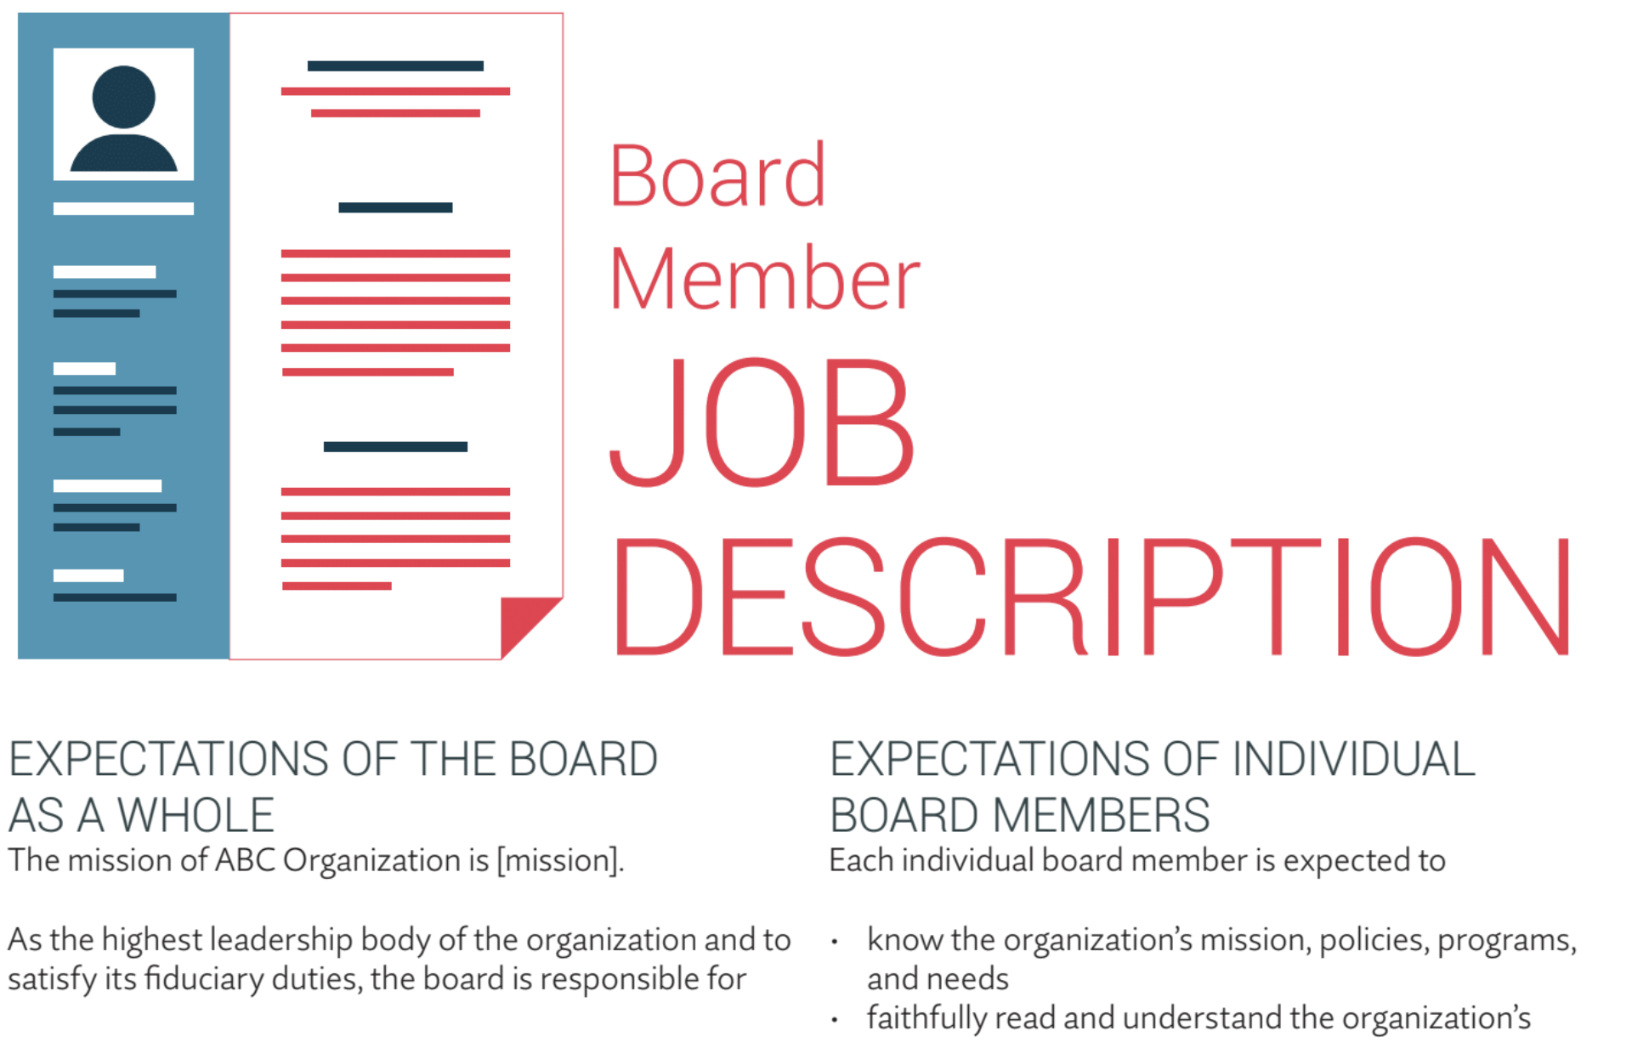
Work Prior to Joining The Board: Written Position Descriptions
BoardSource © [2024]

Slide 18
Expectations of board (top 10 responsibilities of board members)
Individual expectations (attendance, financial, committees, etc.)
Duty of loyalty, care, obedience
Trainings
Work Prior to Joining The Board: Written Position Descriptions
BoardSource © [2024]

Slide 19
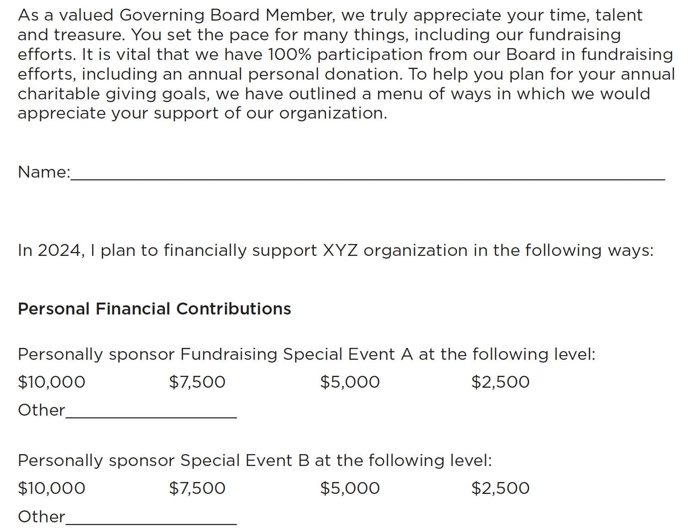
Work Prior to Joining The Board: Investment Opportunities

Slide 20
Ways they can personally give
Volunteer
  Host friend or fundraisers
  Committee service
  Thanking donors
Donate
  Board dues
  General operating support
  Events
Work Prior to Joining The Board: Investment Opportunities

Slide 21
Ways their company support
Volunteer
  Day of service
  Ongoing
Donate
  Grants
  Events
  In-kind
Work Prior to Joining The Board: Investment Opportunities

Slide 22
Thoughts or Questions on Recruitment?

Slide 23
Board Onboarding
What kind of board orientation do you do?
How do you make board members feel welcomed?

Slide 24
Clear Expectations During Onboarding & Service
Host a board orientation session
Assign mentors & provide leadership opportunities
Goal setting (meeting attendance, event support, annual dues)
Conduct self-evaluations
One-on-one touch base meetings annually
**If you don’t have these, this would be a great job for a standing or ad hoc board committee**

Slide 25
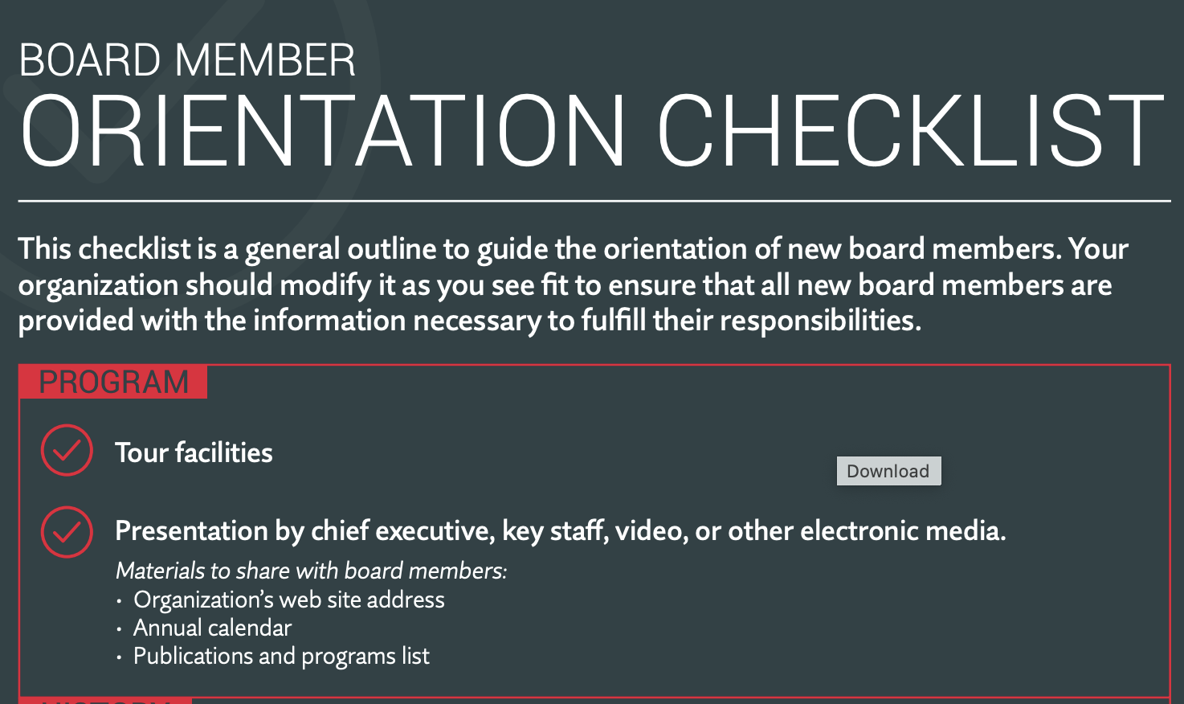
Onboarding: Board Orientation
BoardSource © [2024]

Slide 26
Onboarding:
Board Orientation
Tours
Organization history, leadership, structure, programs
Marketing materials
Policies
Plans: Strategic, development
Expectations
Budgets, financials, 990
Bylaws
Board materials: roster, recent minutes
BoardSource © [2024]

Slide 27
Thoughts or Questions on Onboarding?

Slide 28
Engagement During Board Service
What do you to to ensure effective meetings?
How do you use committees?
How are board members evaluated?

Slide 29
During Service: Effective Board Meetings
Be Efficient
Share required materials for review prior
Assign seats with nametags
Start on time, end on time
Update
Community trends
Program statistics
Partnerships
Peer Engagement
Talking points to board members, committee chairs
Sit with mentors
Highlight Positives
Carrot vs. stick
Engage
Call to action – with what specifically do you need board members to help?

Slide 30
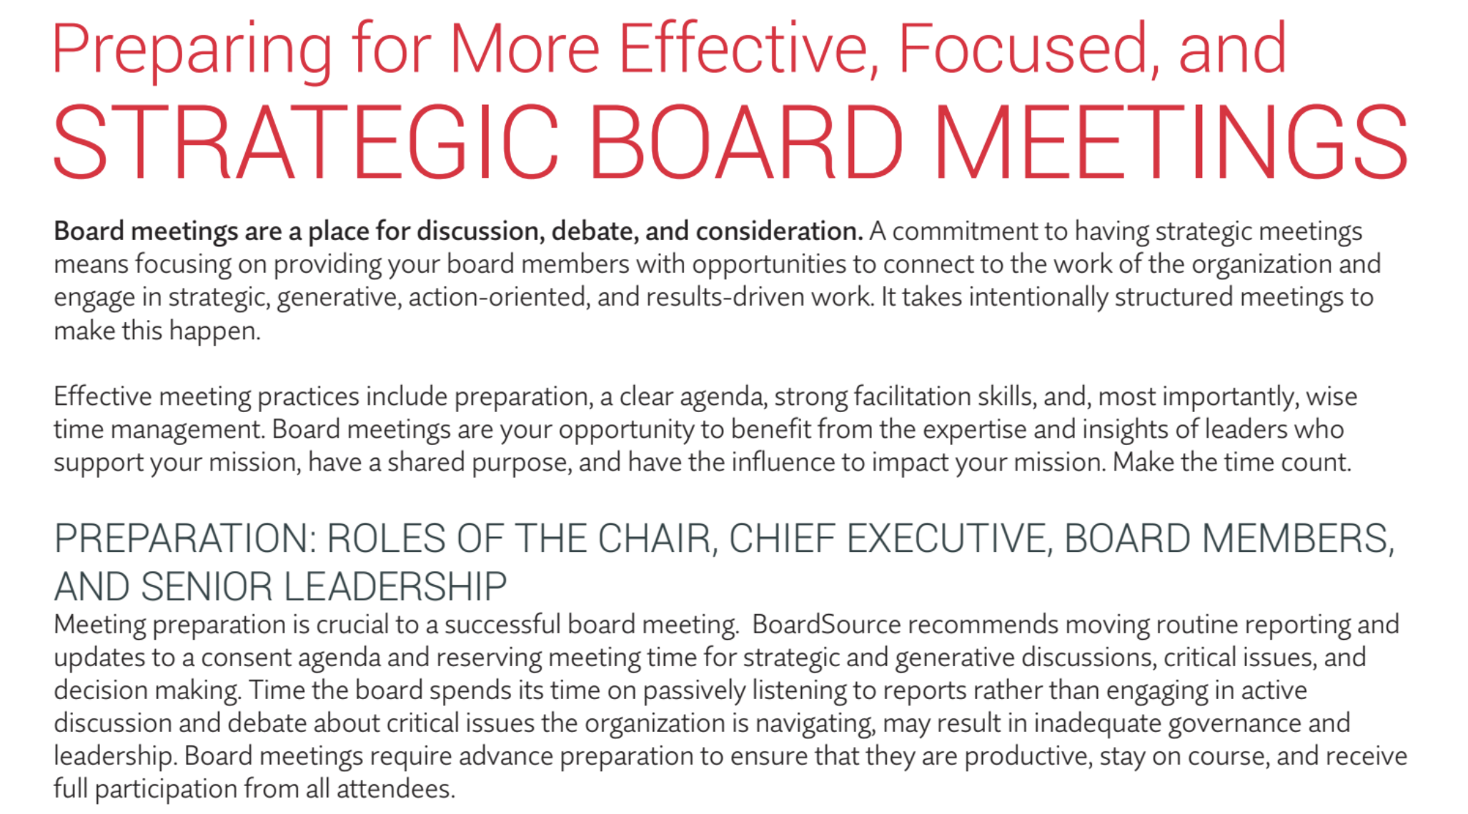
During Board Service: Effective Board Meetings
BoardSource © [2024]

Slide 31
During Board Service: Effective Board Meetings
Prepare full board, board chair and staff leadership team prior
Share roles of full board, chair, and staff leadership at meeting
BoardSource © [2024]

Slide 32
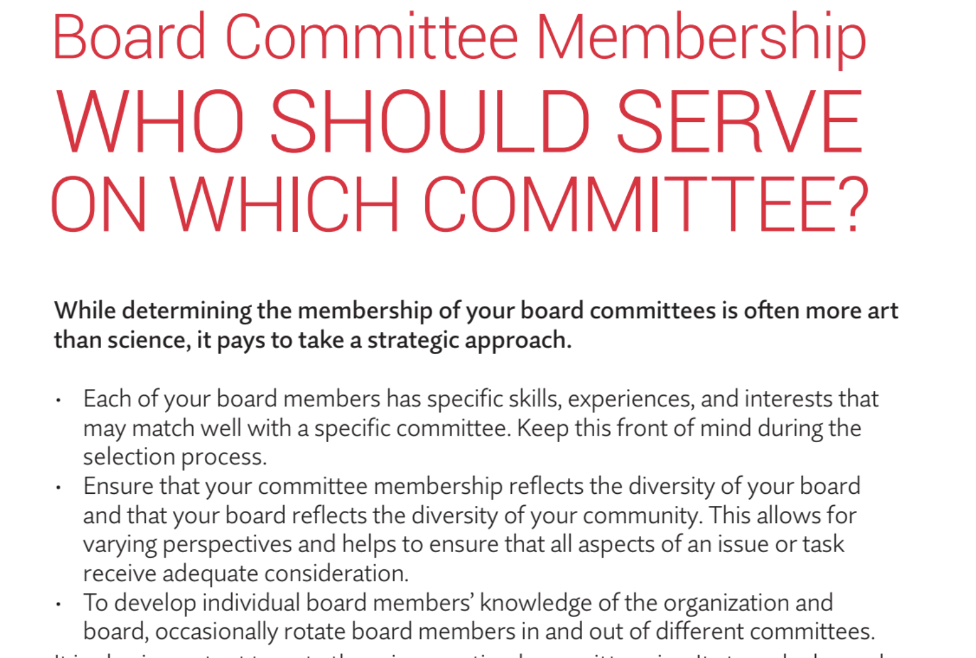
During Board Service: Committee Usage
BoardSource © [2024]

Slide 33
Characteristics of Members and Purposes of Five Most Common Committees:
Governance
Development
Finance
Audit
Executive
During Board Service: Committee Usage
BoardSource © [2024]

Slide 34
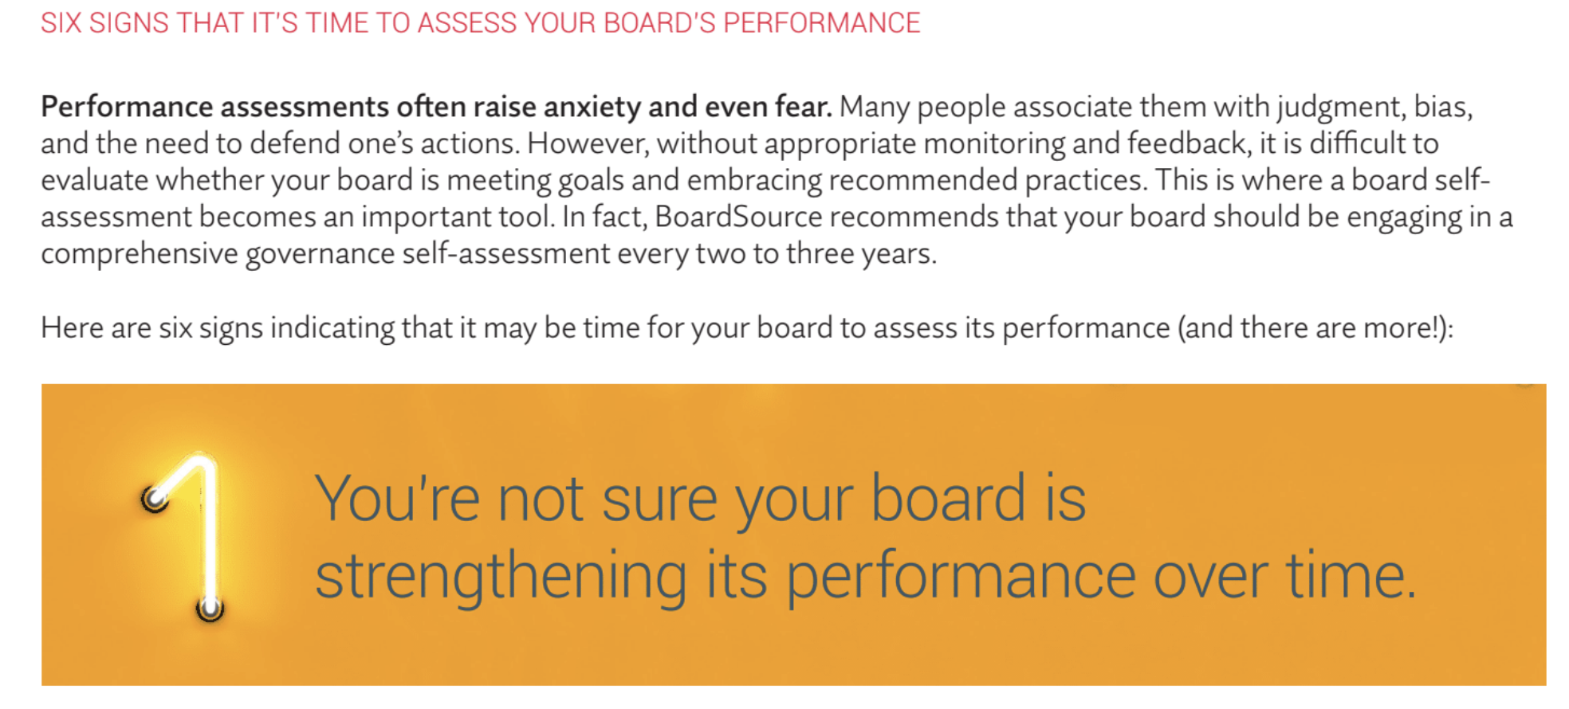
During Board Service: Performance Evaluations
BoardSource © [2024]

Slide 35
Six signs it’s time to assess your boards performance:
Board is not strengthening its performance over time.
Board members are not as engaged as you would like them to be, and you suspect they may not fully understand their responsibilities.
Partnership with and evaluation of the chief executive has room for improvement.
Board could work more effectively and/or efficiently.
Want to demonstrate commitment to best governance practices.
You’re about to start a strategic planning process.
During Board Service: Performance Evaluations
BoardSource © [2024]

Slide 36
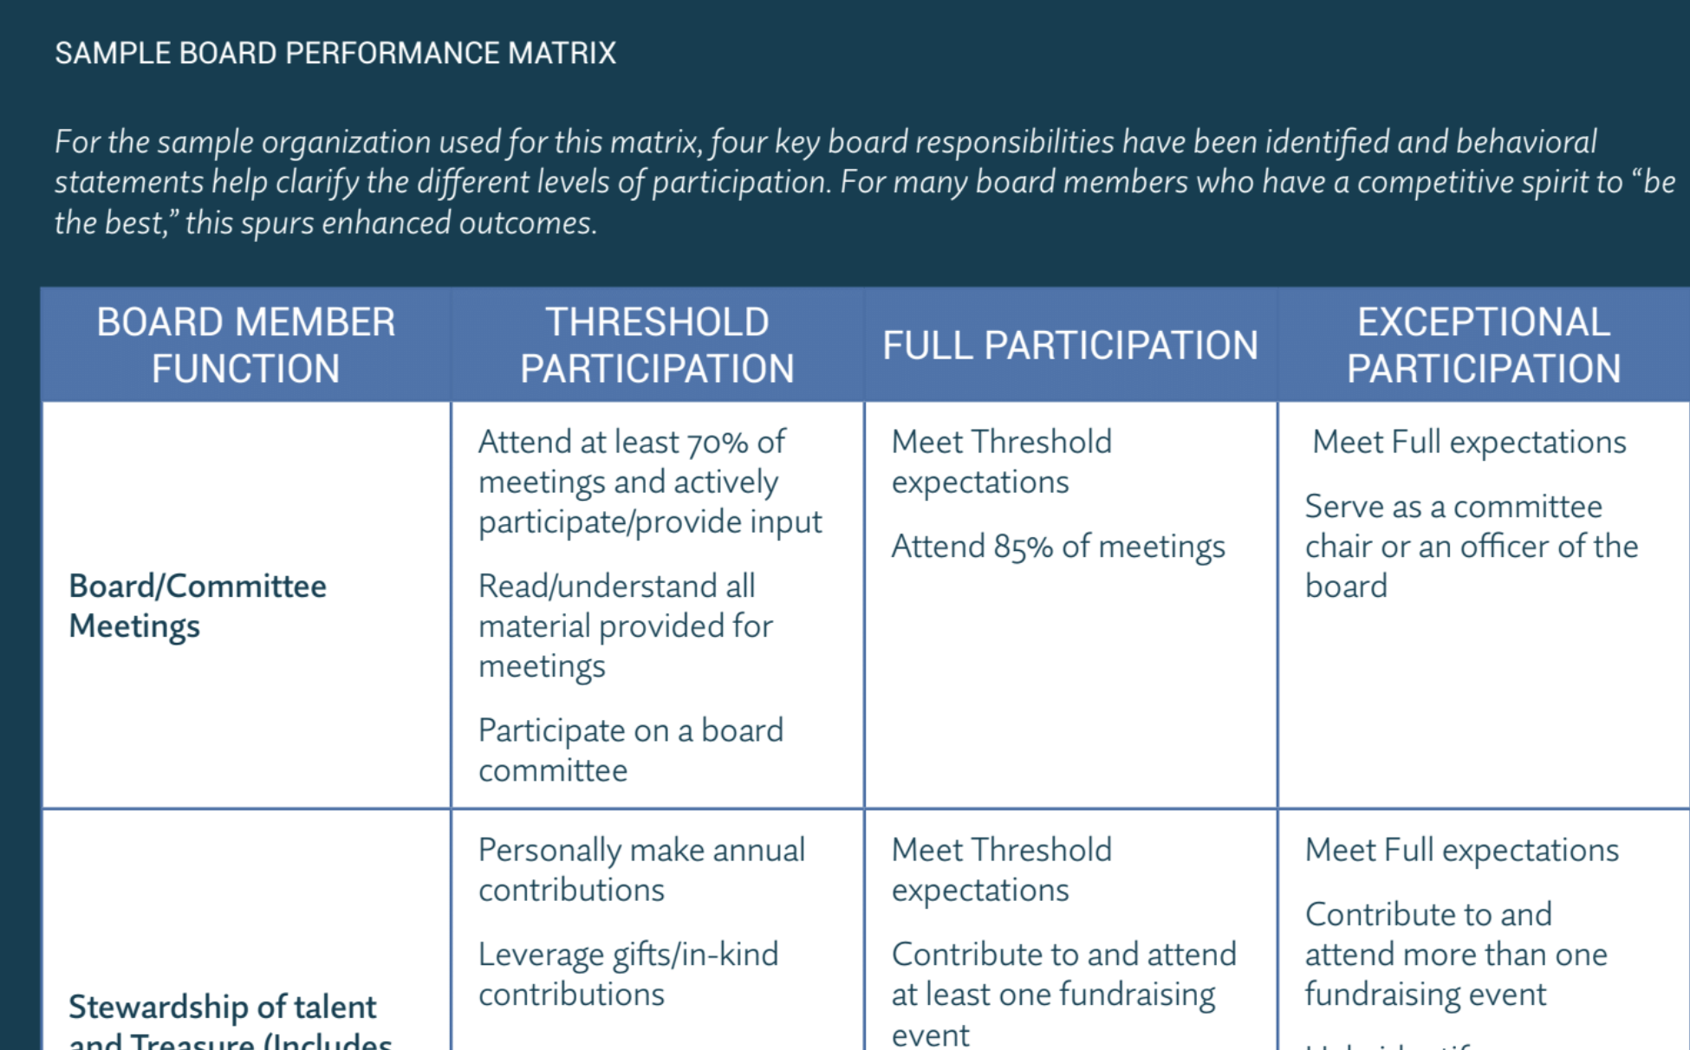
During Board Service: Performance Evaluations
BoardSource © [2024]

Slide 37
During Board Service: Performance Evaluations
How many board members attend each board meeting?
How much are board members giving annually (time and money)?
Are board members educated and engaged in our work?
Do board members serve as ambassadors for the work?
BoardSource © [2024]

Slide 38
Thoughts or Questions on Engagement?

Slide 39
BREAK

Slide 40
Board Education:
Training Opportunities For Clarity

Slide 41
Education: Ten Basic Responsibilities of Nonprofit Boards
- Per BoardSource
North Star
Determine mission and purpose.
Hire Top Leader
Select the chief executive.
Support Leader
Support and evaluate the chief executive.
Planning
Ensure effective planning.
Monitoring
Monitor and strengthen programs and services.
Financial Resources
Ensure adequate financial resources.
Financial Oversight
Protect assets and provide proper financial oversight.
Board Governance
Build a competent board.
Integrity & Ethics
Ensure legal and ethical integrity.
PR
Enhance the organization’s public standing.

Slide 42
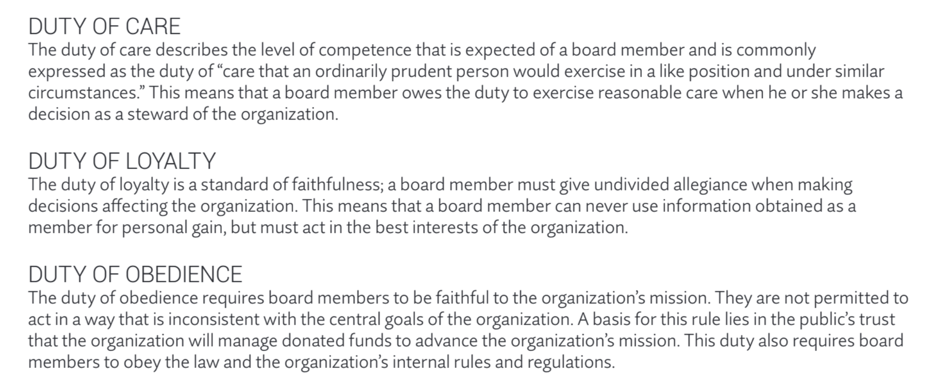
Board Education: Roles & Responsibilities
BoardSource © [2024]

Slide 43
Individual Board Member Responsibilities
Show up
Be informed
Be engaged
Donate
Advocate
Provide parameters (policies, budgets, plans)
Board Education: Roles & Responsibilities
BoardSource © [2024]

Slide 44
Three Duties:
Duty of LOYALTY (organization above self interest)
Duty of CARE (show up, be engaged and informed)
Duty of OBEDIENCE (maintain public trust, faithful to mission)
Board Education: Roles & Responsibilities
BoardSource © [2024]

Slide 45
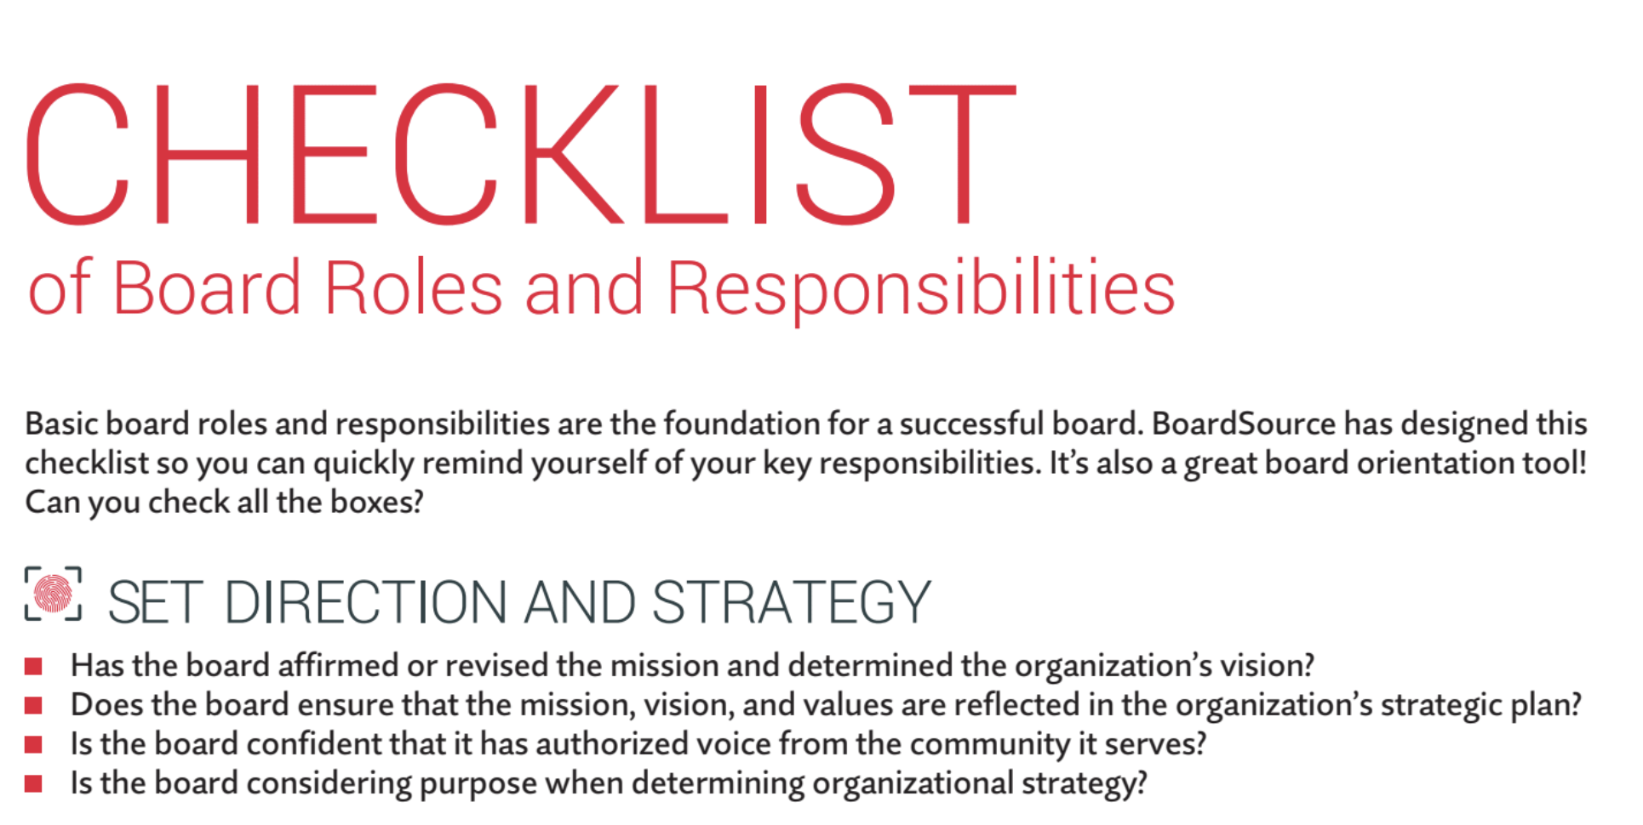
Board Education: Roles & Responsibilities
BoardSource © [2024]

Slide 46
Board Education: Roles & Responsibilities
Set direction and strategy
Ensuring necessary resources
Provide oversight
Board operations
BoardSource © [2024]

Slide 47
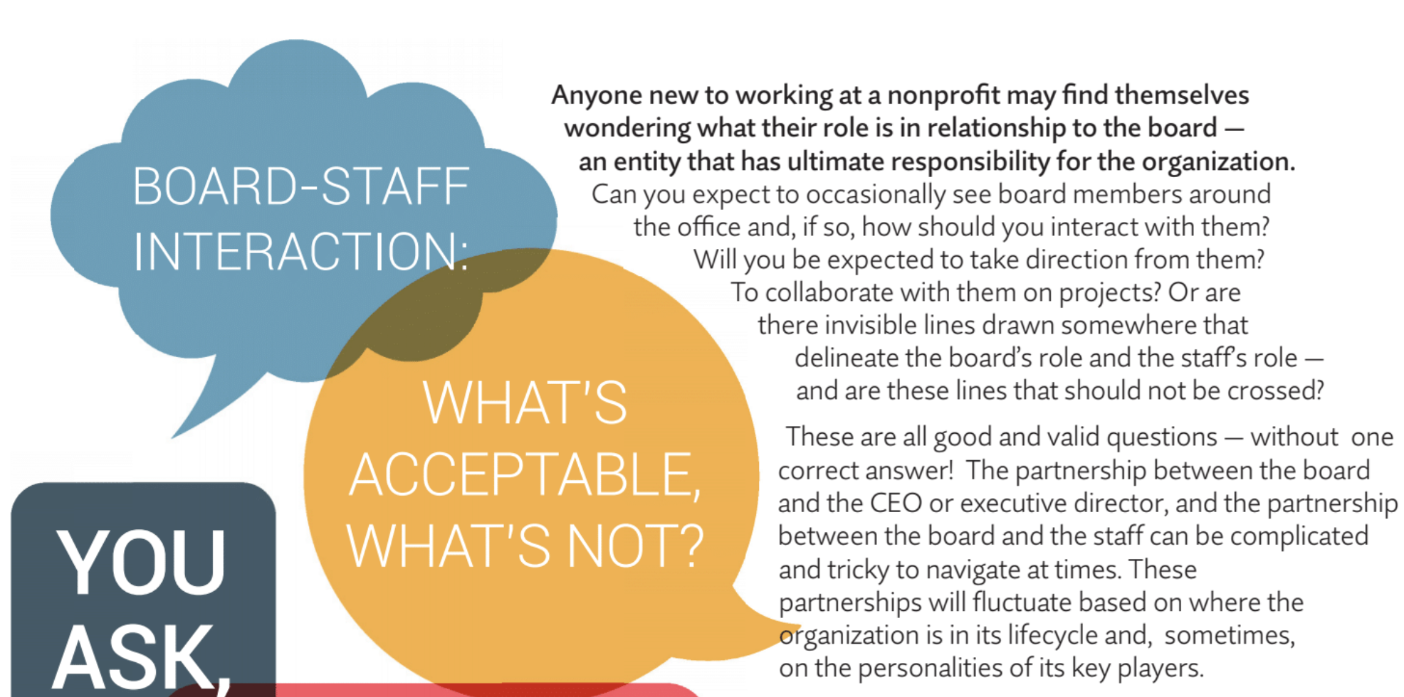
Board Education: Staff Interaction
BoardSource © [2024]

Slide 48
 | Oversight | Planning & Evaluation | Finances
Board | Health & success of organization | Strategic framework for organization | Fiduciary Duty
Chief Executive | Programs and administration | Strategic and operational plans | Financial Management
Board Education:
Staff Interaction
BoardSource © [2024]

Slide 49
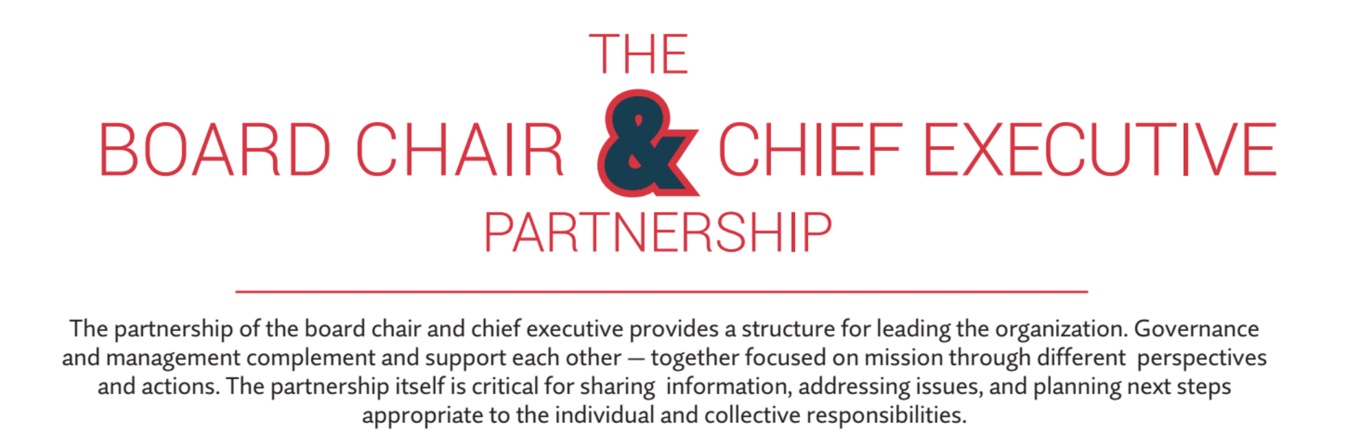
Board Education: Role of Chair
BoardSource © [2024]

Slide 50
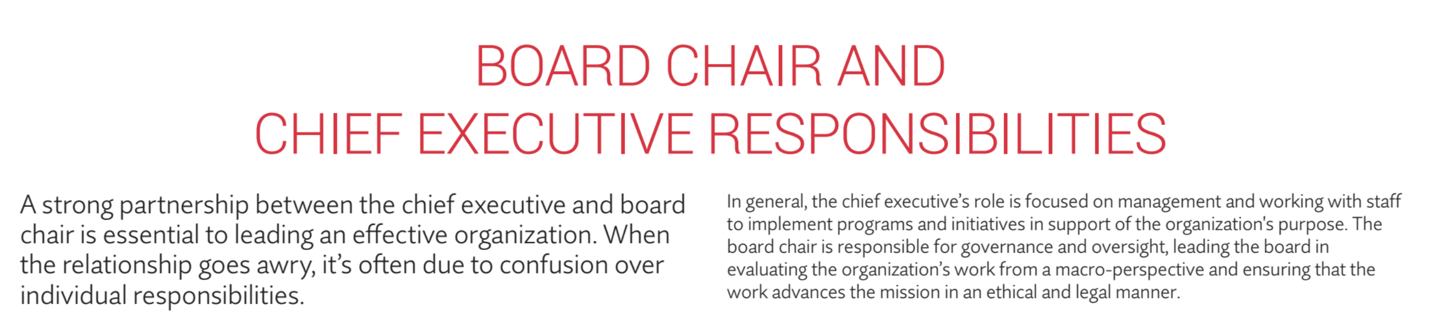
Board Education: Role of Chair
BoardSource © [2024]

Slide 51
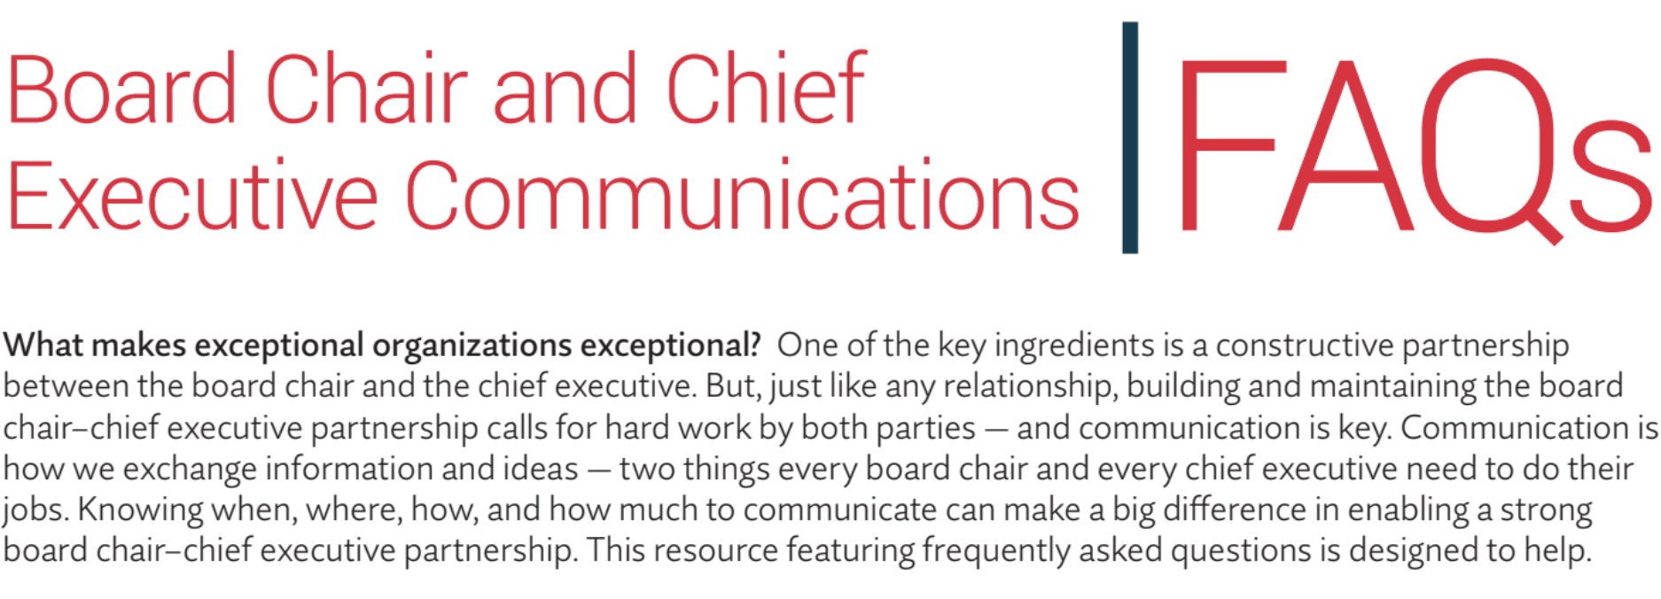
Board Education: Role of Chair
BoardSource © [2024]

Slide 52
Board Chair: Governance, Board Development, Boardroom
Chief Executive: Management, Staff Development, Workplace
Shared: Placing organization first, trust, respect, communications, stewardship, planning, evaluation, financial resources
Board Education: Role of Chair
BoardSource © [2024]

Slide 53
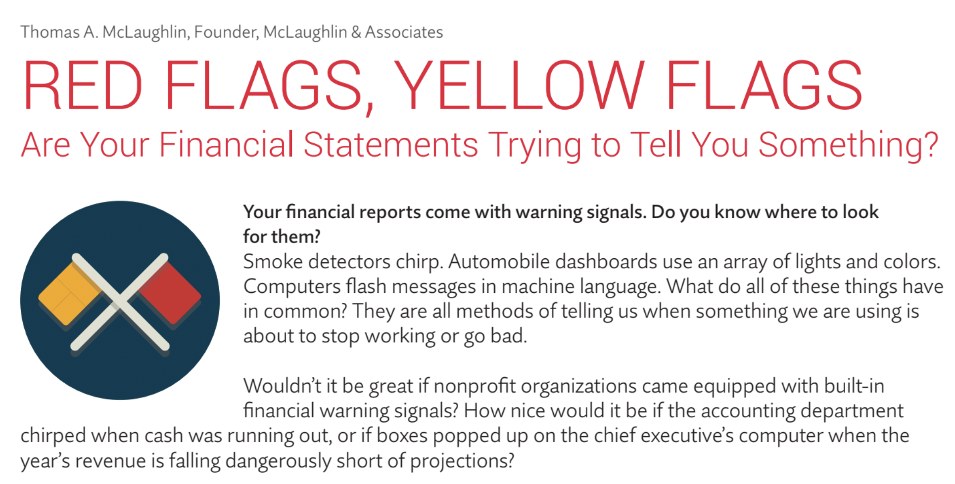
Board Education: Financials
BoardSource © [2024]

Slide 54
Flags to look for in:
Opinion Letter of audited financial statements
Balance Sheet
Income Statement
Financial Statement Footnotes
Board Education: Financials
BoardSource © [2024]

Slide 55
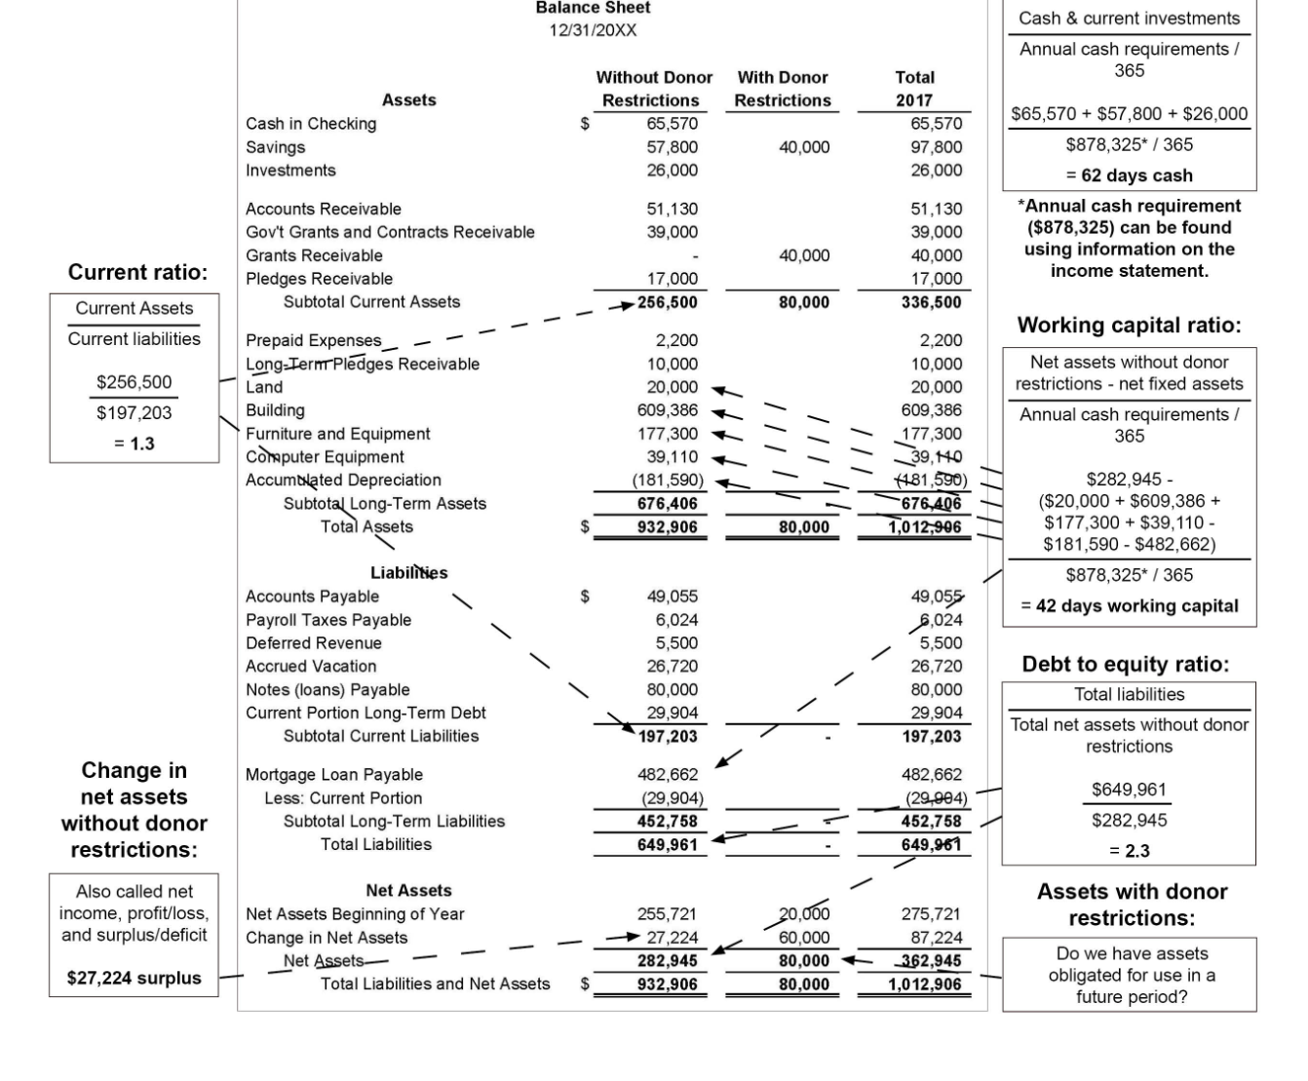
Board Education: Financials
propelnonprofits.org/resources/balance-sheet-cheat-sheet

Slide 56
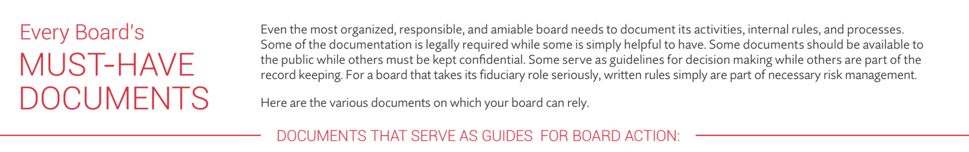
Board Education: Documents
BoardSource © [2024]

Slide 57
Board Education: Documents
Must Have Documents:
Articles of Incorporation
Bylaws
Policies
Board Processes
Documents The Record Board Decisions & Activities
Job Descriptions & Charters
Agendas
BoardSource © [2024]

Slide 58

Board Education: Fundraising
BoardSource © [2024]

Slide 59
Fundraising Communications Toolkit:
Talking points about the organization
Key selling points of the organization
Outcomes, evaluation and effectiveness
Stories and testimonials
How your organization is financed
Board Education: Fundraising
BoardSource © [2024]

Slide 60
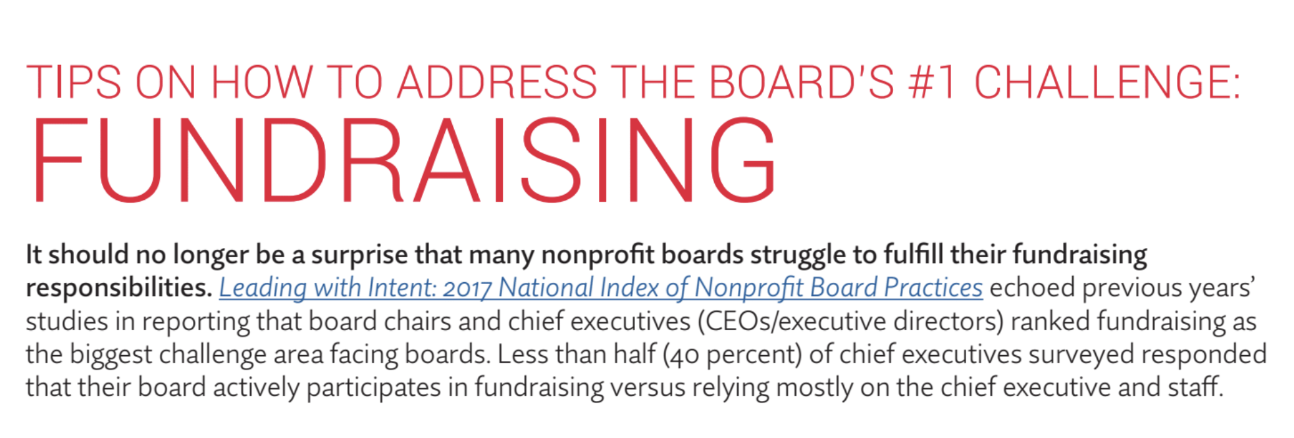
Board Education: Fundraising
BoardSource © [2024]

Slide 61
Recruitment
Make a high priority during recruitment
“When fundraising expectations are clearly articulated during recruitment 52% of CEOs report their boards are highly engaged in the organization’s fundraising efforts.” vs. 12% when not
Board Education: Fundraising
BoardSource © [2024]

Slide 62
Orientation
  Fundraising policy
Personal Giving
  100% participation at whatever level
Fundraising Culture
  Reiterate throughout board terms
Board Meetings
  Include fundraising as a topic each time
Board Education: Fundraising
BoardSource © [2024]

Slide 63
Ways for Board to help without making the ask:
Advocate
Attend trainings
Lead fundraising conversations
Identify and evaluate donor prospects
Thank donors
Events: attend and host others
Donate in-kind items
Donor cultivation
Host events
Attached meetings with donors
Board Education: Fundraising
BoardSource © [2024]

Slide 64
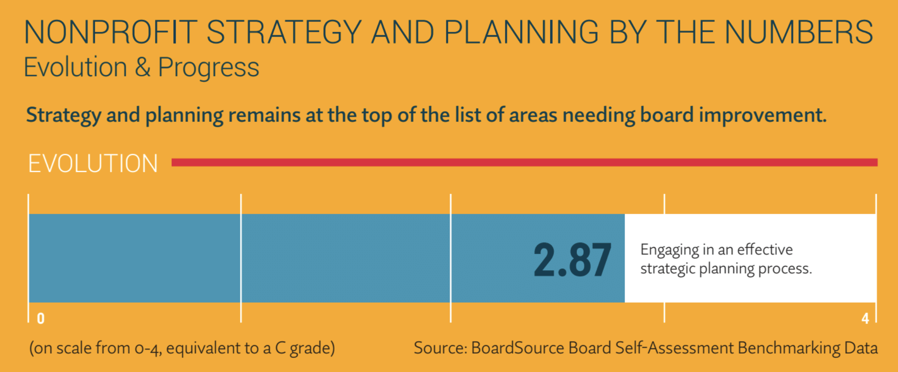
Board Education: Strategic Planning
BoardSource © [2024]

Slide 65
Key qualities of strategic frameworks:
Focus on big picture, not nitty gritty of plan itself
Flexible and nimble
Framework for prioritization and decision-making for management
Board Education: Strategic Planning
BoardSource © [2024]

Slide 66
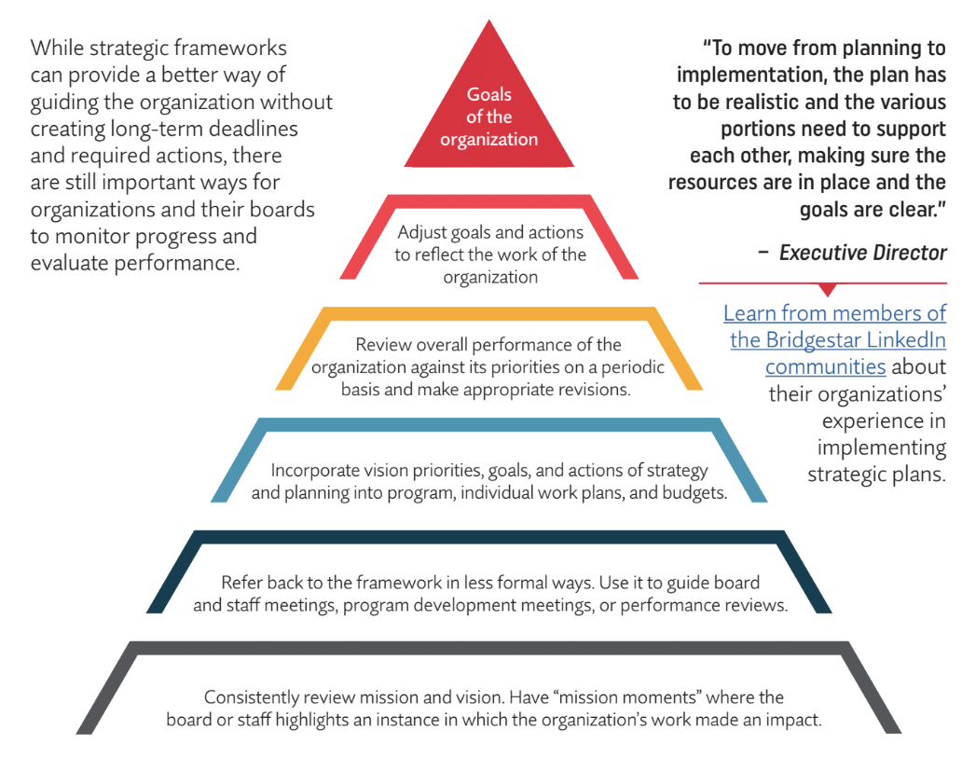
Board Education: Strategic Planning
BoardSource © [2024]

Slide 67
Remember….
  One Thing At A Time
    Start at the beginning with expectation alignment: recruitment, onboarding & ongoing education are key
    Take one resource from today back to your board chair
    Add someone with governance experience to your board
    Incorporate governance moments (mini trainings) given by board chair or experienced board member at each board meeting
    Survey board to see what they want to learn most and start there (gets buy in too)

Slide 68
Additional Information
  Board Governance
    BoardSource (boardsource.org)
      Free and paid resources
      Membership ranges from $500-$3,250 (sliding scale based on the nonprofit budget size)
    IRS (irs.gov/charities-non-profits/irs-training-materials-governance)
    Ohio Attorney General’s Office (ohioattorneygeneral.gov)
    Propel Nonprofits (propelnonprofits.org/resources/balance-sheet-cheat-sheet)
    “The Little Book of Boards” by Erik Hanberg

Slide 69
Final Thoughts or Questions?

Slide 70
Stay Connected:
Adrienne@timetalentandteasurellc.com
timetalentandtreasurellc.com

