Slide 1
Purposeful Principled Leadership
Courageous Leadership
Impacting the Organization by Inspiring the People

Slide 2
May We Never Forget
Twin Towers opened in 1973 and destroyed in 2001

Slide 3
2011

Slide 4
8 Essentials of Effective Leadership
To be Prepared
To be Principled
To understand The Process
To be able to Persevere
To display Professionalism
To Maintain Perspective
To be Personal with the Personnel
To Prepare for the Passage

Slide 5
Inspirational Leaders are Prepared
What is a Leader?

Slide 6
Leadership Defined
The ability to clearly understand and articulate the goal.
The confidence to be out in front and show the way to the goal.
The ability to convince people to follow as an act of their free choice.
The ability to convince people to follow as an act of their free choice.
The desire to help people develop and pursue excellence.
The ability to inspire people to achieve their full potential.
6

Slide 7
Visible Behaviors of a Leader
01
Decisive
02
Good listener
03
Keeps commitments
04
Consistent
05
Good judgement
06
Fair
07
Gives recognition
08
Removes work barriers
09
Equips followers
10
Emphasizes principles not just rules
7
Notes:
Picture : https://www.freepik.com/premium-photo/human-resources-management-recruitment-concept-magnifying-glass-is-searching-human-icon-top_8366112.htm

Slide 8
Why is there significant agreement on the VISIBLE BEHAVIORS of effective leaders . . .
BUT VERY LITTLE DEMONSTRATION IN OUR EXPERIENCE?
8

Slide 9
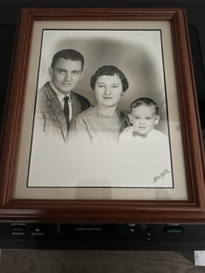
PREPARATION
Do we use the past as an excuse or lessons learned?
Are we Victims or Survivors?
Are we Givers or Takers?

Slide 10
Preparation Was it Modeled?
Work Ethic
Reliability & Dependability
Integrity
Humility
Service
Stewardship
Loyalty
Notes:
“I should have bought more Snickers Bars”
Paid Cash for everything

Slide 11
Preparation What We Witness Matters
Dignity
Fidelity
Courtesy
Competency
Compassion
Tenacity
Determination
Notes:
How we treat our coworkers matters

Slide 12
Organizational Life Cycle
Identify principles
Share Principles. Develop procedures
Emphasize procedures. Neglect principles
Procedures rejected. Principles forgotten
Where is your organization?
Decline from excellence
Vision of excellence
Struggle to excellence
Achievement excellence

Slide 13
It Begins with You

Slide 14
Inspirational Leaders are Principled
What is our foundation?

Slide 15
Inspirational Trustworthy Leaders are PRINCIPLED
Conviction to Principles
Create Critical Mass of commitment to Principles
Objectives & Strategies are Specific
Detailed Plans
Call Direct Supports to Take Action
Institutionalize AND Personalize Feedback
Create Accountability (Instruction AND Discipline)
Consistently reinforce the Principles

Slide 16
A Principle
Motivating Force
Basic truth, law, doctrine, or motivating force
A rule of conduct, especially right conduct, integrity (Person of Principle)
Law
Broad statement of Truth
Truth
A principle creates a firm foundation
Principle
16

Slide 17
Ten Ancient Principles
True North
01
Time tested
02
Universal application
03
Provide inner compass
04
Good results when applied
05
Positive impact on society
06
Other principles find origin in these ten

Slide 18
Principle #1
Submit to Authority
Understand the importance of the flow of authority
Action Step
Submit to legitimate authority

Slide 19
Principle #2
Serve others first (not self)
Do not serve / pursue gain for yourself exclusively
No inflated ego
Action Step
Develop a spirit of service to others

Slide 20
Principle #3
Keep your commitments
History: God’s name was used to formalize agreements or commitments.
Stabilizes relationships and reduces need for litigation
Action Step
Become a person of your word

Slide 21
Principle #4
Pursue a balanced life
Rest vs. Work
Balance: Physical, Intellectual, Spiritual
Action Step
Evaluate your need to adjust your schedule and balance your life

Slide 22
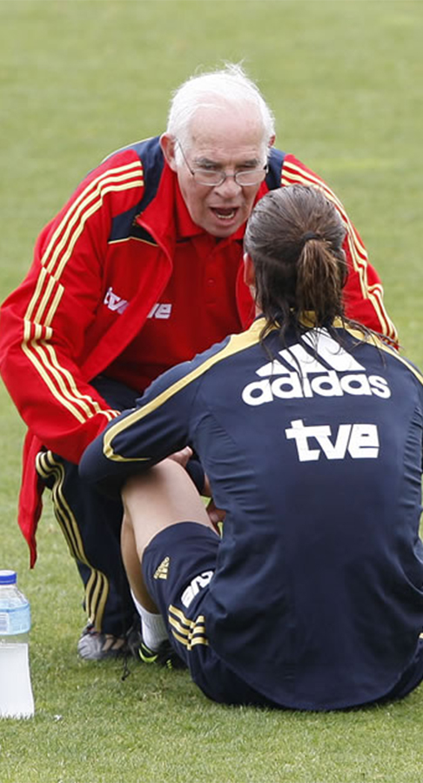
Principle #5
Honor age & experience
Show gratefulness for what you receive from others
Results in wisdom, tranquility, and continuity
Action Step
How can you honor those who have contributed to your life?

Slide 23
Principle #6
Respect all Human Life
No lesser status based upon race, gender, age or anything else
Action Step
Become aware of your role in protecting those who depend on your leadership and influence.

Slide 24
Principle #7
Protect Your Family
Importance of family institution; marital fidelity
Commitment to family most solemn societal relationship
Betrayal of family erodes trust in other relationships
Action Step
Make a determined commitment to honor your family in all areas of your life

Slide 25
Principle #8
Respect the Property of Others
Goes beyond stealing
Includes trespassing, vandalism, denying privacy
Prevents social instability and interpersonal conflict
Action Step
Make a personal decision not to take materials from work or steal time from your employer

Slide 26
Principle #9
Tell the Truth
To be honest
Results in mutual trust, respect and compatibility
Nothing but the Truth
Action Step
Seek to be straightforward and clear in your contacts with others

Slide 27
Principle #10
Be Content with What You Have
Contentment: a state of mind
It is possible to have much and not be content; and to be poor and be content
It is not the man who has too little, but the man who craves more, that is poor. Seneca (4 BC – AD 65)
Action Step
Develop a grateful spirit and positive attitude

Slide 28
We are unequal in many ways.
However, we are equal in capacity and potential for character.
28

Slide 29
Managers & Leaders
Warren Bennis: “On becoming a leader.”
Inspires
Motivates
Leader
Manager
Innovates
Develops
Focus on people and abilities
Inspires trust
Asks what and why
Originates tasks
Does the “Right things”
Administers
Maintains
Focus on systems and structure
Relies on control
Asks how and when
Fulfills tasks
Does “Things right”

Slide 30
Inspirational Leaders understand the Process
Are Leaders born or made?

Slide 31
PROCESS
“If you want to change the agency are you
FIRST willing to change yourself?”

Slide 32
Process & Self Deception Vienna General Hospital 1800’s
Mortality Rate 1 – 10 Mothers Died in the Physicians Ward
Mortality Rate 1 – 50 in the Midwife Ward
Ignaz Semmelweis

Slide 33
Definition of Character
Character “…those moral qualities that constitute the nature of a leader and shape his or her decisions and actions.”
The result of a consistent, disciplined application…
(Practice/Habits)
…of the principles…
(Basic Truths)
…one has chosen to pursue.
USMA (West Point) Officers Manual
(Values)

Slide 34
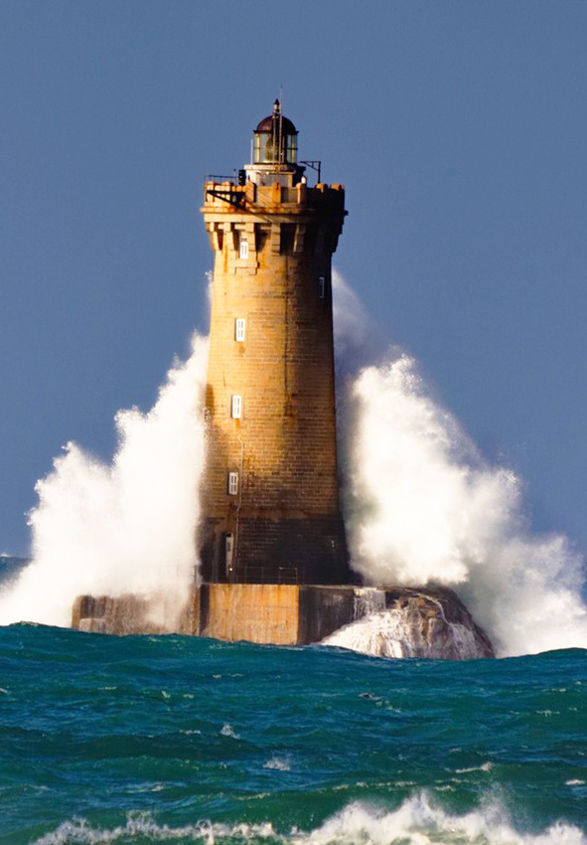
The foundation for character
Integrity
Courage
Discipline
Loyalty
Diligence
Humility
Optimism
Conviction

Slide 35
Consistent leadership behavior demands well developed character traits
How firm is your foundation for inspirational, trustworthy character?

Slide 36
Integrity versus deception
Actions match stated beliefs
Consistent & predictable
Oneness as opposed to duplicity
Believable: People are more likely to follow someone they trust
Tells the truth
Integrity is not something you can turn on and off like a light switch!

Slide 37
Integrity
TRUST . . . Like fine china once broken, can be repaired . . . but it is never quite the same.
Chinese Proverb
37

Slide 38
Application
INTEGRITY at work & home
What aspects of INTEGRITY need to be sharpened in your life?
SPECIFIC ACTIONS you will take in the next 30 days at work and home.
38

Slide 39
Courage versus cowardice
Overcoming fear
Courage cannot exist outside the presence of Fear
39

Slide 40
Courage versus cowardice
Overcoming fear
Two major fears that Leaders face
01.
The Fear of Failure
02.
The Fear of Rejection
40

Slide 41
Courage versus cowardice
Physical Courage
Moral Courage
Overcoming fear
Principle over expediency
Doing what is “Right”
Seizing the initiative
Courage cannot exist outside the presence of Fear
41

Slide 42
Moral Courage matters as much as Physical Courage

Slide 43
Application
COURAGE at work & home
What aspects of COURAGE need to be sharpened in your life?
SPECIFIC ACTIONS you will take in the next 30 days at work and home.
43

Slide 44
Discipline versus disorder
No one wants to give control of their life to someone who can’t control his own
Self control
Remaining calm and cool in crises
Maintaining objectivity
Fairness
44

Slide 45
Application
DISCIPLINE at work & home
What aspects of DISCIPLINE need to be sharpened in your life?
SPECIFIC ACTIONS you will take in the next 30 days at work and home.
45

Slide 46
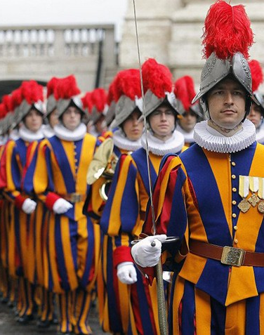
Loyalty versus unfaithfulness
I lead . . . therefore, I follow.
Submission to legitimate authority
Being under authority, grants authority
The Swiss Guard
Honor Chain-of-Command
“He who has never learned to obey cannot be a good commander.” Aristotle 384-322BC
Allegiance as opposed to flattery or sycophancy

Slide 47
Loyalty verses unfaithfulness
The exception of principle versus preference:
IS THE ACT ILLEGAL, IMMORAL, OR UNETHICAL?
47
Notes:
US Military to address an issue to a superior: Sir/Madame, do I have permission to speak frankly?

Slide 48
Application
LOYALTY at work & home
What aspects of LOYALTY need to be sharpened in your life?
SPECIFIC ACTIONS you will take in the next 30 days at work and home.
48

Slide 49
Diligence versus laziness
Hard work, persistence, consistency
49

Slide 50
01
Hard work
Diligence versus laziness
Pursue excellence beyond success
02
03
Objective orientation
04
Commitment
50

Slide 51
Application
DILIGENCE at work & home
What aspects of DILIGENCE need to be sharpened in your life?
SPECIFIC ACTIONS you will take in the next 30 days at work and home.
51

Slide 52
Humility versus arrogance
Concern for the interest of others
01
Demonstrated by good Listening skills
02
03
Admits when wrong
04
Results in more ideas & learning
Demonstrated through the concept of servant leadership
05
06
Compassion & gratitude
07
Wisdom in counselors
52

Slide 53
Application
HUMILITY at work & home
What aspects of HUMILITY need to be sharpened in your life?
SPECIFIC ACTIONS you will take in the next 30 days at work and home.
53

Slide 54
Optimism versus pessimism
Enthusiasm is
contagious . . .
confidence begets
confidence
01
Focus on objective rather than obstacles
02
Realistically address obstacles
03
Expect the best from those you lead
04
Catch people doing something good

Slide 55
Application
OPTIMISM at work & home
What aspects of OPTIMISM need to be sharpened in your life?
SPECIFIC ACTIONS you will take in the next 30 days at work and home.
55

Slide 56
Conviction versus uncertainty
01
Confidence, certainty and passion
Founded on knowledge, truth & personal application
02
03
Requires study and effort
04
Speaking with certainty is persuasive
05
Leading with doubt creates doubt
06
Strong conviction is evident
56

Slide 57
Application
CONVICTION at work & home
What aspects of CONVICTION need to be sharpened in your life?
SPECIFIC ACTIONS you will take in the next 30 days at work and home.
57

Slide 58
Process of Leadership
Lifetime Learner
Ability to Collaborate
Understand Cultural Wisdom
Understand Innovation

Slide 59
Inspirational Leaders Persevere
How do we tap into our Resilience?

Slide 60
“It is what it is. It will become what I make of it.” Coach Pat Summit

Slide 61
Resilience
What do you think or have been taught that contributes to resilience?
Who have you witnessed that has in your opinion displayed great resilience?
Consider the most significant challenge you’ve faced in life and how did you get through it and what did you learn about yourself?
D
Notes:
This could substitute for slide 12 which is currently hidden. Jack or Russ can try to lead the class through this.

Slide 62
William E. YOUNG – Stalker
1998
2017
1998-2017

Slide 63
Emotional Intelligence
Contributors
Self Awareness
Social Awareness
Emotional Regulation
Knowing ourself and awareness in the moment, of our thoughts and behaviors
Observe other’s behaviors to seek to understand what is going on with them-to best communicate, influence, understand and motivate them
Using self awareness to choose what to do under our direct emotional control
Notes:
I animated this slide to roll through the contributors. Russ can stay through this slide emphasizing the emotional intelligence highlights. “Ourself” replaced “Yourself”

Slide 64
Marcus Aurelius “Meditations”
“So other people hurt me? That’s their problem. Their character and actions are not mine. What is done to me is ordained by nature, what I do by my own.”

Slide 65
The Apostle James
“Count it all joy, my brothers, when you meet trials of various kinds, for you know that the testing of your faith produces steadfastness (perseverance). And let steadfastness have its full effect, that you may be perfect and complete, lacking in nothing.”
This Photo by Unknown Author is licensed under CC BY-SA

Slide 66
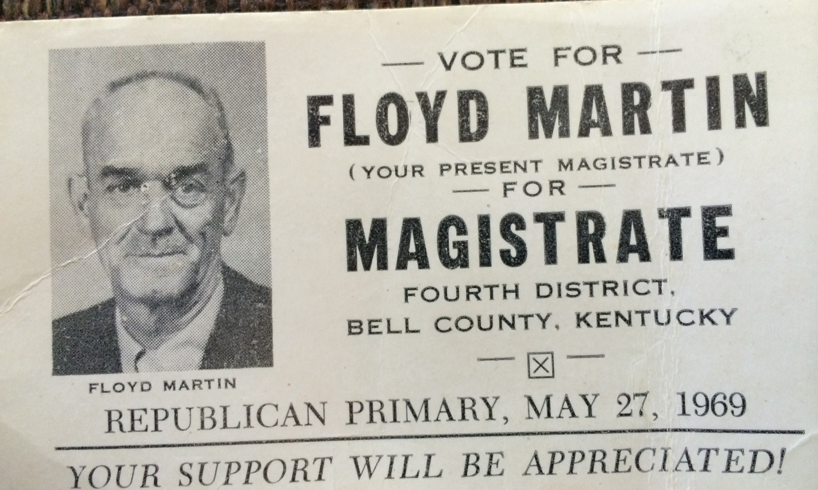
Black Lung

Slide 67
Inspirational Leaders are Professional
Are you JUST meeting standards?
Is mediocrity the new professionalism?

Slide 68
Roman Statesman
“To err is human….”
“Any man can make mistakes, but only an idiot persists in his errors.”
Cicero

Slide 69
”Going Pro” The Deliberate Practice of Professionalism by Tony Kern
Vocational Excellence | Professional Ethics | Continuous Improvement | Professional Engagement | Professional Image | Selflessness | L 3
Vocational Excellence | Professional Ethics |  |  |  |  | L 2
Vocational Excellence |  |  |  |  |  | L 1

Slide 70
Level 3 Leadership

Slide 71
Inspirational Leaders maintain Perspective *The Job AND The People
Do you see the bigger picture?
*Bad News Welcome Here

Slide 72
Expect the Unexpected Iceland March 2010

Slide 73
Inspirational Leaders Love the People “Teach those that don’t know and discipline those that don’t care.”
Patient
Kind
Treat others the way you want to be treated
Supports Others
Listens with Humility
Not Irritated
Teaches, Corrects & Disciplines
Looks for Expected Behavior & Reinforces it
Treats each Honestly

Slide 74
Personal with the Personnel
Impactful Leaders are present in the moment

Slide 75
Prepared
Process (Ongoing)
Principled
Perseverance
Professional
Perspective

Slide 76
“The best you can hope for at the end of your career
Is to be respected. If you’re liked that’s a bonus. When
You’re in Leadership the decisions you make will impact
many and some will simply not like you.”
Asst. Chief (retd.) Bob Vernon LAPD

Slide 77
Peaceful Passage
“It’s just as important how you leave the room as how you enter it.
Your LEGACY begins the moment you arrive and it’s etched
into stone how you exit. How do you want to be remembered?”
Sheriff (retd.) Russ Martin

Slide 78
A Life Well Lived… What I Learned in Life, Law Enforcement, Leadership and Love
rmartin@leadershipdeveloped.com
740.272.3087
It worked for me…

Slide 79
Legacy
Who has invested in you?
Who is currently invested in you?
Who are you investing in?
How do you want to be remembered?
Notes:
How do you want to be remembered?

